Slide 1



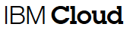
Incubation Lab
&
Development Factory
May 11, 2015
William A Brown
brownaw@us.ibm.com

Slide 2

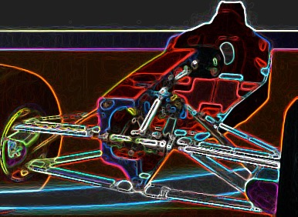
What is the “Incubation Lab & Development Factory”?
A Pre development environment where we create improve, transform and maintain new and existing products for a rapidly changing market place.
Process - Built on Agile and Lean methods enabling fast Discovery, successes, failures, learning and recoveries
People - Product Dedicated Teams that work in well defined sprints enabled by the shared services of the Lab
Technology - An isolated Sandbox – Isolated from the customers enterprise so that legacy road blocks don’t effect innovation
Built-in Analytics
Upgradable components
Continuous testing
Well-designed component interfaces
Rapidly replaceable
components
Controls
Clearly documented

Slide 3

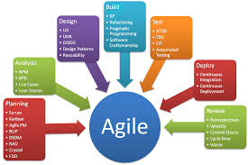
What the “Incubation Lab & Development Factory” Offers
A Pre development environment to create, improve, transform and maintain new and existing products then advance the product to leverage iterative build factory.
Process - Built on Agile and Lean methods enabling fast Discovery, Successes, Failures, Learning and Recoveries
People - Product Dedicated Teams that work in well defined sprints enabled by the shared services of the Lab
Technology - An Development Factor Isolated from the encumbrances of the customers legacy enterprise & road blocks
What we offer Our Customers
Fast PoC Bluemix Development
Bluemix Strategy
Bluemix Development Mentoring
Product and Project Selection
Extreme Programming Mentoring
Bluemix Deployment Options - Cloud Foundry. Containers, Virtual Machines
Runtimes and Boiler Plate Selection
Services Selection - Watson, IoT, Mobile, Integration, Customer Owned
Bluemix Options - Subscription, Dedicated PaaS, Local PaaS
IBM Resources
Cloud Strategy and Consulting
Bluemix Architecture Skills
Extreme Programming Resources
Lean and Sprint Coaches
DevOps Resources
Bluemix Managed Platform and Sklils

Slide 4
Incubation Lab & Development Factory
A Pre development environment to create, improve, transform and maintain new and existing products then advance the product to leverage iterative build factory.
Process - Built on Agile and Lean methods enabling fast Discovery, Successes, Failures, Learning and Recoveries
People - Product Dedicated Teams that work in well defined sprints enabled by the shared services of the Lab
Technology - An Development Factor Isolated from the encumbrances of the customers legacy enterprise & road blocks
Primary Use Cases
Project Characteristics
New API product idea test market validation
New System of Engagement product idea test market validation
Proof of concept validation
Minimum viable product creation
Hackathons to identify new product ideas
Rapid application change in response to market imperatives
Rapid environment readiness required
Assisted Agile development
Development teams interested in leveraging a large public, private, and proprietary services pallet
Rapid continuous development and delivery
Standardized development environment with reusable assets
Isolated environment to minimize enterprise risk

Slide 5
Incubation Lab & Development Factory vers Roll Your Own
IBM
100+ Bluemix public services
Software solutions deployed & maintained in Incubation Lab
Bluemix
Rational Team Concert
UrbanCode Deploy
API Management
API Harmony
Pre-defined Agile development process & tools
Experts for guidance
Agile coaches
Lean masters
Banking models
Global bank experience with model
Time to acquire capabilities = weeks
Homegrown
Catalog of custom developed and publically available services and a need to add, maintain and improve catalog
Unknown current state of Agile development process
Need to acquire and deploy a collaborative development platform
Need to acquire and deploy a PaaS platform
Need to develop Agile, Lean, and Banking models skills
PNC first of a kind
Time to acquire capabilities = > XX months

Slide 6
Timeline Comparison
Weeks
Incubation Lab Process
 | Weeks
Activity | 1 | 2 | 3 | 4 | 5 | 6 | 7 | 8 | 9 | 10 | 11 | 12
First Pilot Project
Sprint 0 – Discovery & Prioritization
Sprint 1 – MVP 1
Sprint 2 – MVP 1
Sprint 3 – MVP 1
Setup & Configure Lab Sandbox
Months
Traditional Process
*Note: This high level timeline is for planning purposes only. Implementation timelines will vary and should be refined as part of an implementation plan once specific requirements are understood in detail.
 | Months
Activity | 1 | 2 | 3 | 4 | 5 | 6 | 7 | 8 | 9 | 10 | 11 | 12
Project
New Tech Process
Security Review
Provision Environment
Waterfall Development Process
Setup & Configure Lab Sandbox

Slide 7
Sandbox Lab Provisioning & Setup (1st time vs Follow on Projects)
Initial Sandbox Provisioning | Weeks
Activity | 1 | 2 | 3 | 4
Sandbox Setup and Configuration
Provision PaaS Environment
Provision DevOps Environment
Provision & Setup RTC Platform
Provision & Setup UCD Platform
Provision & Setup MobileFirst Platform
Provision & Setup GIT SCM
Configure Template MobileFirst Pipeline
Configure Template Micro Services/Web Pipeline
Per Project Provisioning & Setup | Weeks
Activity | 1
Sandbox Setup and Configuration
Provision MobileFirst Pipeline Instance
Provision Micro Services/Web Pipeline Instance

Slide 8

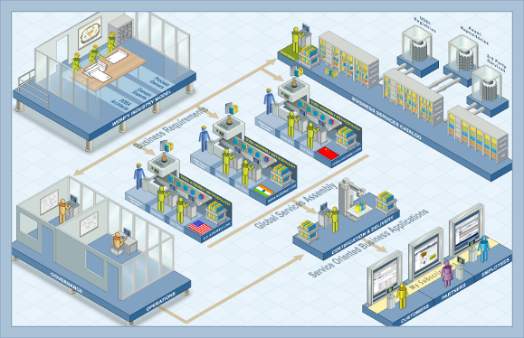
The Incubation Lab & Development Factory Concept
An incubator for Product Innovation and Transformation
A “Factory” for Services, Application & API development at Speed
Focused on people, process and technology
A permanent part of the Corporate landscape and transformation
Use of Lean Startup and Disciplined Agile concepts
Three Patterns – Systems of Engagement, Interaction and Record
Increased velocity, frequency, standardization achieved with a development factory model
Development, Test Sandbox– Bluemix, Local or Dedicated with Public/Private Srv Pallet
Architecture/Design Center
EA
Bluemix, Local or Dedicated DevOps Control Point
Lean Startup/ Agile Method & Scrum Teams
Architecture/Design Center
Scrum Teams
PaaS/Virtual Environments
MIS Teams
Product Owners
PMO/Project Intake & Prioritization
Development
PMO
Operations Engs
DevOps
EA/SMO

Slide 9
The Incubation Lab & Development Factory
Roles & Responsibilities
Role | Responsibility
PMO | Project Management & Metrics, structures multiple Agile Development Teams
Architecture Design Team | Provides SMEs, shared services, Standards, emerging trends to Dev Factory
Agile Development Team | Solution Realization, Development, Testing, Config Mgmt, Deplymt , Interact with Prod Owner, Continuous Deploy, Metrics
Product Owners | Owns Product Goals, Direction and Vision, Drives Agile Dev team to realize the vision
Architects | Designs the solution and technical direction
Scrum Masters/Coach | Coaches the team on delivery, removes roadblock, a scrum expert
Operation Engineers | Ensures the environment can support the solution in development and release
Developers | Code Development, Realization of Solution Design

Slide 10
Environment for “Incubation Lab & Development Factory” The Technology
API Manager/Gateway
Carrier Grade Firewall/ Direct Link
API Manager/DataPower
API Manager/DataPower
Scrum Teams Access Sandbox
Bluemix Local – Bluemix & Micro Services
Product Owners Constant Interaction
Bluemix Public & Dev/Ops Build and Deploy
API Manager/Gateway Simulated APIs used for Isolation Testing
Services/ESB/Host Systems
Services/ESB/Host Systems
BIAN/Banking Models (IFW) services

Slide 11
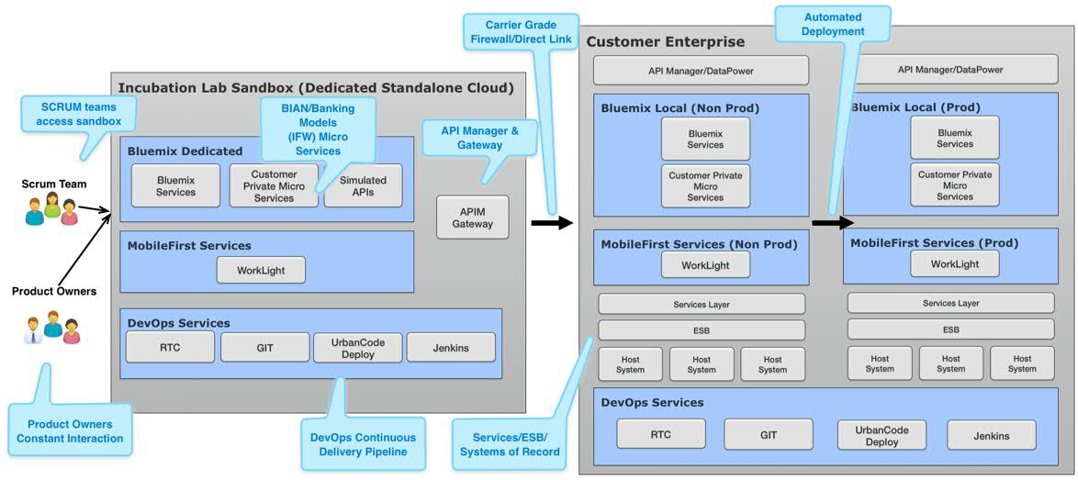
Environment for “Incubation Lab & Development Factory” The Technology

Slide 12
IBMs Delivery Approach for Lab & Development Factory
The Process
Discover -- Discovery, Alignment, Prioritization
Define Lab & Factory Initiative Mission, Environment, and Organizational Operating Model
Customize your operational framework – organization, process, technology using BIAN/Banking Models(IFW) to identify and prioritize “Hot” business functional areas
Identify “Hot” Focus Areas and Align with Business Objectives, Prioritize for Market need
Define Actionable, Prioritized Roadmap from Business Functional Areas
1
2
Exploit -- Design, Develop, Release
Design, Develop Release product in set sprints
Incorporate continuous feedback from Product Owner
Improve product and ready for Test Market release
Incubation Lab & Development Factory in Operation
3
Improve -- Monitor, Feedback, Improve
Monitor and Collect Feedback from Test Market Users
Analyze Feedback and validate product target
Incorporate Leanings to Improve, Iterate process

Slide 13



The Incubation Lab & Development Factory Project Implementation The Process
1
Systems of Engagement (SOE) Top Down Track
Identify Value Add Business Proposition and Goal for a System of Engagement Product with a Profile and Targeted Market
Identify a Product Owner to drive value and Vision
Create a Lean Start up Agile team and Eco-system for project success
Decompose the larger vision into deliverable products and new application
Prioritize projects, Identify existing frameworks and approaches needed to satisfy product goal
Identify or build APIs and micro services needed to enable the leveraging of services for multi-channel consumption
Simulate API’s & Data to support service components
Create Time Boxed Sprints
Execute, Produce, Monitor, Evaluate results, Repeat.

Slide 14
The Incubation Lab & Development Factory Pattern 2
The Process
2
API Development Middle In Track
Identify Value Add Business Proposition and Goal for the API Product
Define a Product Profile and Targeted Market
Identify a Product Owner to drive value and Vision
Assemble a Lean Start up Agile Team
Identify Services and/or Micro Services needed to Enable Multi-Channel Consumption
Simulate Data to support service components
Create Time Boxed Sprints
Execute, Produce, Monitor, Evaluate results, Repeat.

Slide 15
The Incubation Lab & Development Factory Pattern 3
The Process
3
Systems of Record (SOR) Bottom Up Track
Iteratively Execute Design Approach to identify SORs that map to “Heat Map” Functional area
Identify and Confirm the SoR Owner
Leverage services to improve SORs
Validate Mapping of Existing Services to SORs
Simulate Data to support service components
Create New Services to componentize existing applications and Decompose/Decouple monolithic systems
Determine Channel Exposure, If applicable Feed to Pattern Two

Slide 16




Incubation Lab & Development Factory Team
The People
Innovation
Projects
Discover – 2 in a Box
Customer
IBM
Key Principles
Small team with cross-functional skills
Focus
Identify Business Goals and Drive Value Add Outcomes
Discover Business Functional Domains for Development and or Improvement
Business Domain Product Owner
Lead Business Arch/Coach

Slide 17



Incubation Lab & Development Factory Team
The People
Innovation
Projects
Exploit – 4 + 1 in a Box
Customer &/or IBM
Owner
Arch
Lead Coach/ Scrum Master
Key Principles
Small team with cross-functional skills
Focus
Exploit Identified Opportunities
Fast build-measure-learn cycles
Frequent interaction with real/actual end users
Developer
Ops Engineer

Slide 18
Incubation Lab & Development Factory Team
The People
Innovation
Projects
Improve – 4 + 1 in a Box
Customer &/or IBM
Owner
Arch
Lead Coach/ Scrum Master
Key Principles
Small team with cross-functional skills
Focus
Exploit Identified Opportunities
Fast build-measure-learn cycles
Frequent interaction with real/actual end users
Developer
Ops Engineer

Slide 19
The Incubation Lab & Factory Approach
Pilot EXAMPLE – Internal API
Starter APIs for Internal Hackathon
Goal: Develop up to 5 APIs that expose system of record services for internal developer hackathons
Identify a product owners to drive value and vision
Define a product profiles and targeted market for the SOR APIs
Assemble a Lean start up and Agile team
Wire APIs and micro services needed to enable the application components and services
Create any new services required leveraging existing frameworks or models where possible (e.g., Retrieve Customer Details)
Build for multi-channel consumption
Create time boxed sprints
Execute, produce, monitor, evaluate results, repeat
People | Process | Technology
Customer SCRUM team – “4 in a box” | Lean startup | Bluemix or Dedicated Sandbox
IBM Experts – API SME & Agile Coach | Agile development methodology | APIs front ending supporting web services

Slide 20
The Incubation Lab & Factory Approach
Pilot EXAMPLE – External API
Extend Existing applications through APIs to Software Vendors
Goal: Develop an API that provides services which can be exposed to multiple channels. The API should be for use by software vendors to integrate with the providers application and services.
Identify a product owner to drive value and vision
Define a product profile and targeted market for the Services APIs
Assemble a Lean start up and Agile team
Wire APIs and micro services needed to enable the application components and services
Create any new services required leveraging frameworks and models where possible
Build for multi-channel consumption
Create time boxed sprints
Execute, produce, monitor, evaluate results, repeat
People | Process | Technology
Customer SCRUM team – “4 in a box” | Lean startup | Bluemix or Dedicated Sandbox
IBM Experts – API SME & Agile Coach | Agile development methodology | APIs front ending supporting web services

Slide 21
The Incubation Lab & Factory Approach
Pilot – EXAMPLE – System of Record
SoR Re-architecture
Goal: Apply Lean and Agile development approaches to the maintenance and update activities of Systems of Record. Identify functional areas of change in the existing application and prioritize them
Perform a decomposition of the functional areas to identify service and API opportunities
Prioritize the identified services and APIs
Create a development Sprint backlog
Create time boxed sprints
Execute, produce, monitor, evaluate results, repeat
People | Process | Technology
Customer SCRUM team – “4 in a box” | Lean startup | Bluemix or Dedicated Sandbox
IBM Experts – Banking Models experts | Agile development methodology and possibly waterfall for certain service development activities | BIAN/IFW Web Services and non-IFW based Web Services

Slide 22
The Incubation Lab & Factory Approach
Banking Pilot EXAMPLE – System of Engagement
Wearable Version of Virtual Wallet Application
Goal: Develop a version of Virtual Wallet for wearable devices
Identify a product owner to drive value and vision
Create a Lean start up and Agile team
Develop a UI/UX and components required for the development of Virtual Wallet “wearable” application which leverages existing Web Based Banking (WBB) or OnLine Banking (OLB) services
Wire APIs and micro services needed to enable the application components and services
Create any new services required leveraging BIAN/Banking Models (IFW) where possible
Build for multi-channel consumption
Create time boxed sprints
Execute, produce, monitor, evaluate results, repeat
People | Process | Technology
Customer SCRUM team – “4 in a box” | Lean startup | Bluemix or Dedicated Sandbox
IBM Experts – API SME & Agile Coach | Agile development methodology | Wearable app, APIs, web services, etc.

Slide 23


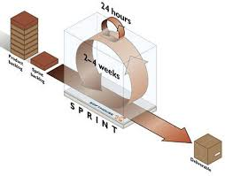
The Incubation Lab & Development Factory Project Pilot Scope
IBM will implementing upto 4 services in a 6 week pilot MVP mobile app effort built using the Bluemix on IBM owned platform dedicated to the customer:
Consult and Mentor in the strategy for creating APIs, using Agile, Lean & Extreme Programming techniques.
Identify Business Proposition & Goal for the Pilot Product
Identify a Product Owner to drive value and Vision
Consult with customer to define a product Profile and Targeted Market
Create a Bluemix Development Space, Assets and Services.
Create a Lean Start up Agile team with Co-Located IBM and Customer Resources
Decompose the larger pilot product vision into deliverables
Identify & Build APIs, Services and/or Micro Services needed to Enable Multi-Channel Consumption
Identify & Acquire from customer Simulated Data to support service components
Prioritize projects, Create Scrum Sprints and a Sprint Backlog to fit the pilot time box
Develop, Release, Monitor, Analyze Feedback & Repeat to Improve

Slide 24








Hindi
Thai
Gracias
Traditional Chinese
Russian
Spanish
Thank You
Obrigado
Brazilian Portuguese
Arabic
Danke
Grazie
Merci
Italian
German
French
Tamil
Simplified Chinese
Korean
Japanese

